Slide 1



SMART UNDERWRITING
DATA-DRIVEN HOME INSPECTION INSIGHTS

Slide 2


TEAM
Ashvin Raj Chu-Yun Hsiao Raghav Chadha Xiaoyu Guan Yi-Chun Huang

Slide 3
AGENDA
01
04
BUSINESS PROBLEM
DATASET
02
05
ANALYTICAL PROBLEM FRAMING
MODEL BULIDING
03
06
METHODOLOGY
DEPLOYMENT AND BENEFITS

Slide 4
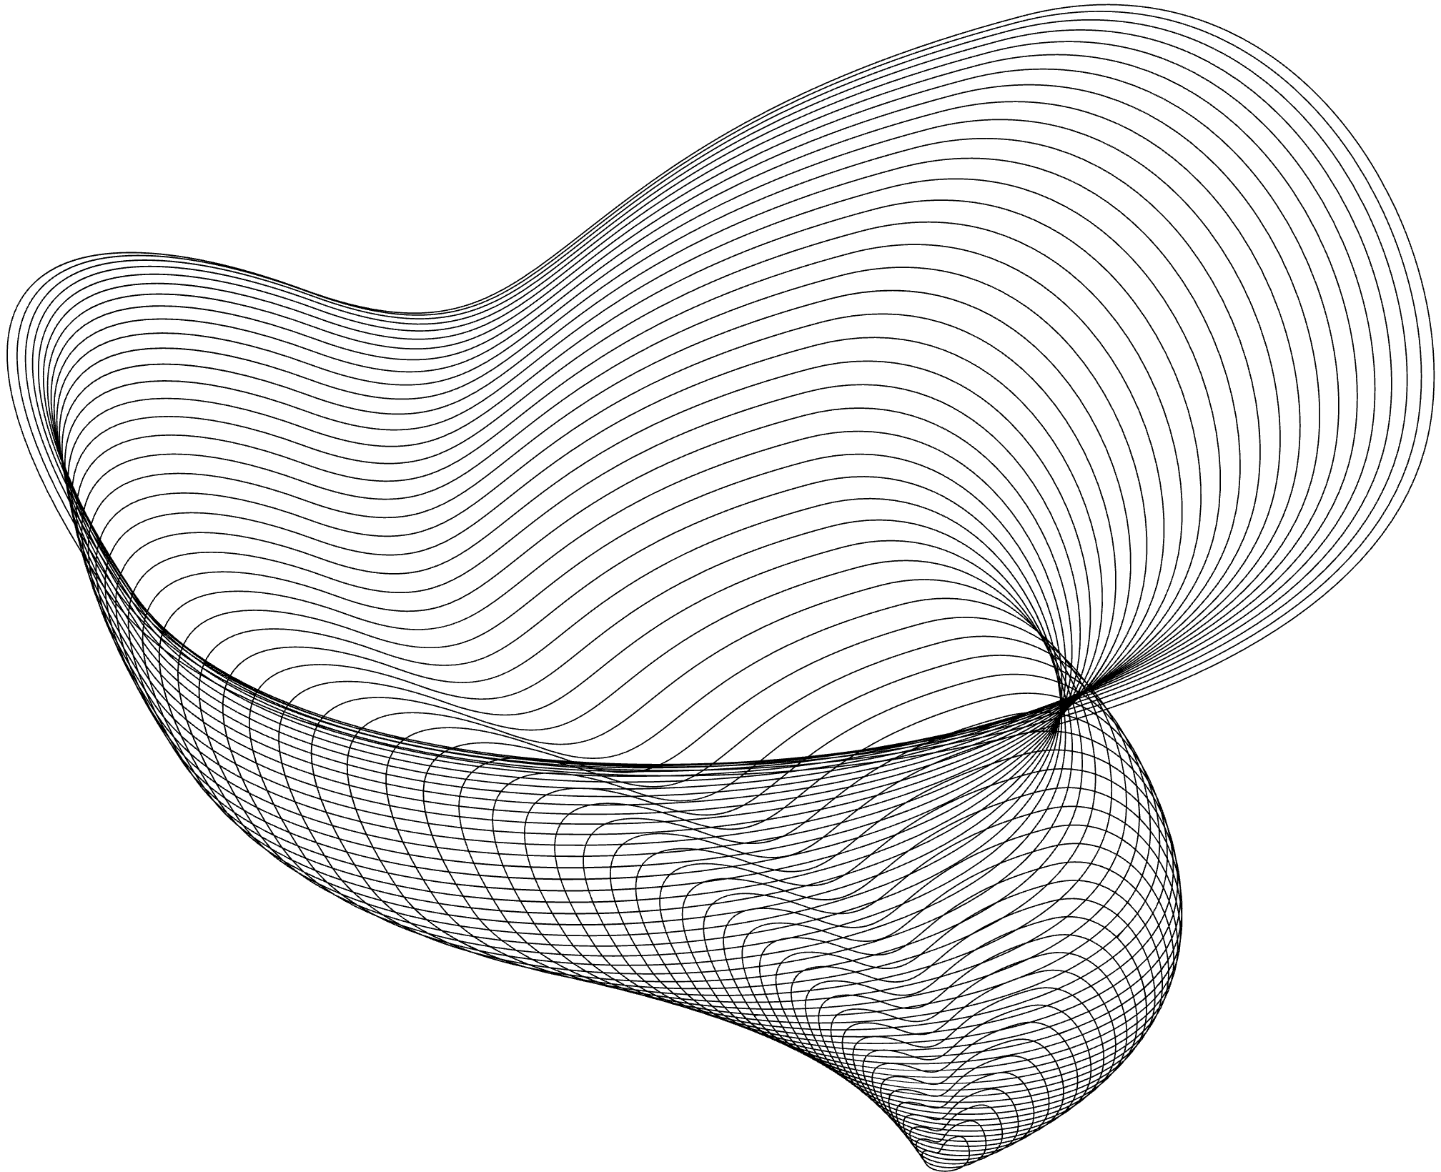





INTRODUCTION
House insurance inspections are vital evaluations of a property's condition, structure, systems, and risks. These results guide decisions on property insurance suitability, coverage levels, and pricing.

Slide 5

PROJECT OVERVIEW
MISSION:
Develop an enhanced predictive model that more accurately identifies properties requiring inspections.
Determine the key risk factors influencing inspection needs.
Recommend strategic actions to mitigate risks associated with high-risk properties.
GOAL:
Develop effective machine learning models to gain insights on house inspection prediction. Propose business strategies to proactively screen high-risk houses at the quote stage.

Slide 6

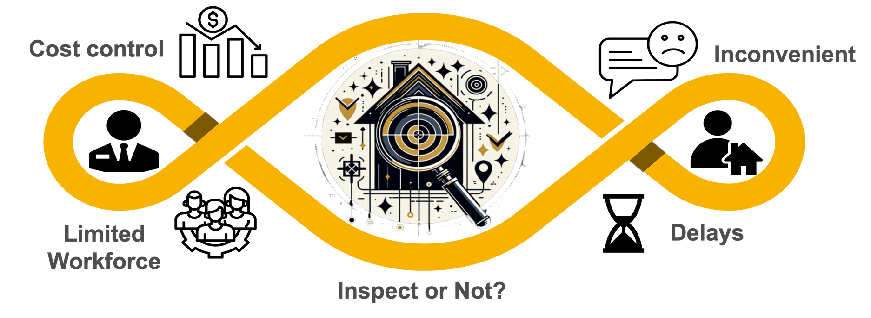

BUSINESS PROBLEM

Slide 7
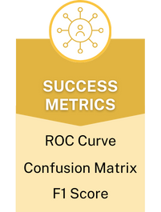
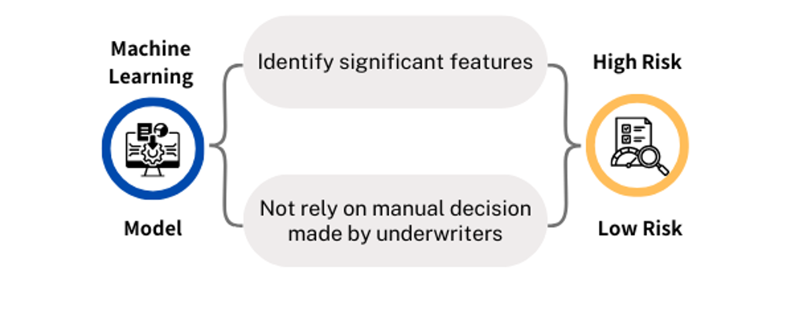
ANALYTICS PROBLEM FRAMING

Slide 8
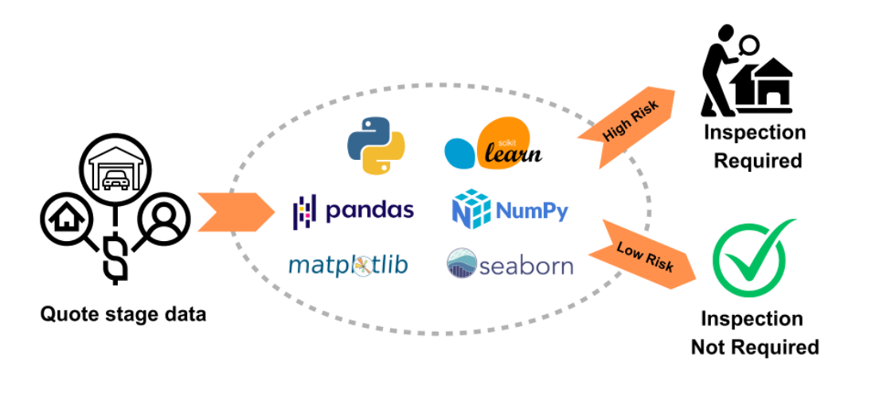
TECHNOLOGY FRAMEWORK

Slide 9








METHODOLOGY
BUSINESS UNDERSTANDING
DATA UNDERSTANDING
DATA PREPROCESSING
MODELING
EVALUATION
DEPLOYMENT
EXPLORATORY DATA ANALYSIS
NULL-VALUES AND DUPLICATES TREATMENT
FEATURE ENGINEERING
XGBOOST
MODEL COMPARISON
PREDICTION
DATA
IDENTIFY CHANGES ACCROSS TABLES
ENCODING CATEGORICAL VARIABLES
RANDOM FOREST
DATA BINNING
LOGISTIC REGRESSION
CREATE DUMMY VARIABLES FOR DATA CHANGES
IDENTIFY TARGET VARIABLES

Slide 10
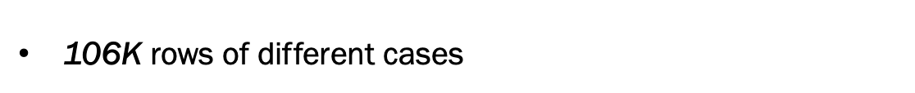
DATASET
OVERVIEW
Quote stage inspection data merged
with SCD and Policy table
Target Variable composed of
3 key variables
Cleaned Dataset -> 94K rows

Slide 11
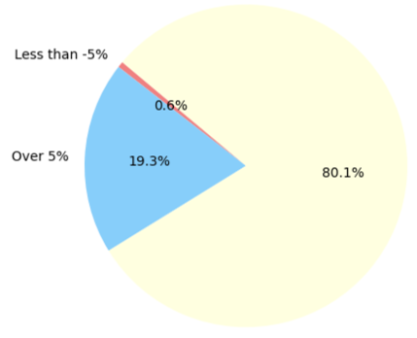
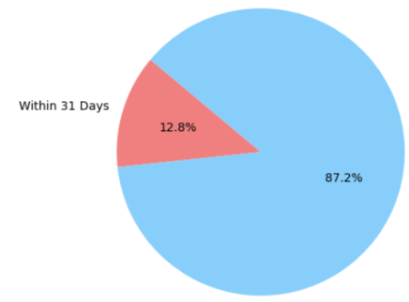

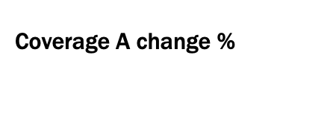
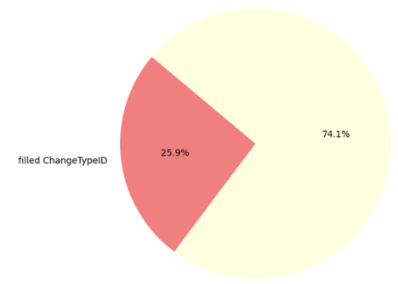
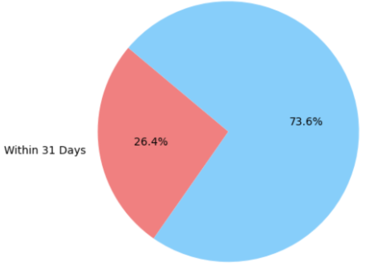
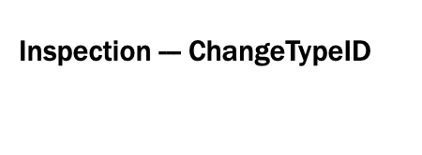

DATASET
EDA

Slide 12
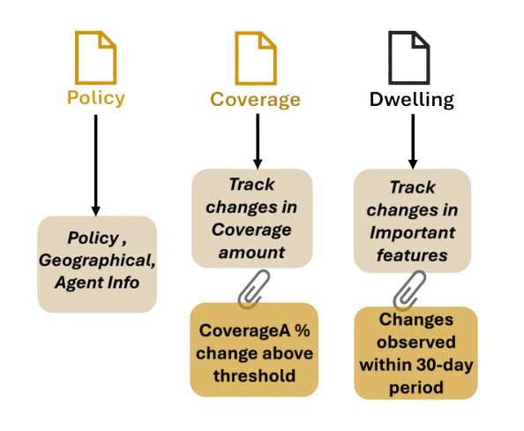
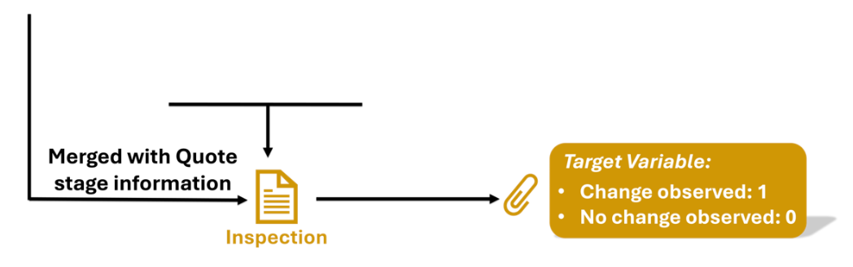
DATASET
PREPROCESSING
Treat NaN values
Drop values / Impute based on logic
Duplicate Inspection records
Retain Most recent record
based on DwellingRequestID

Slide 13






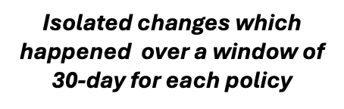




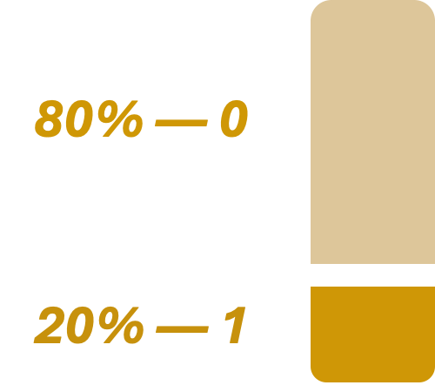
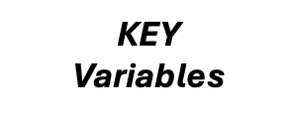


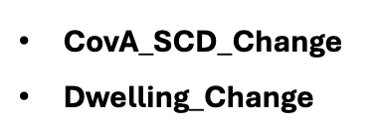
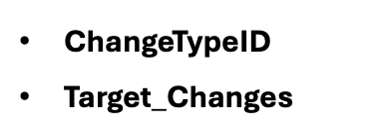

DATASET
PREPROCESSING

Slide 14
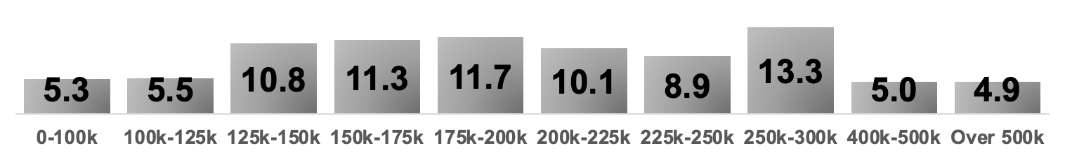
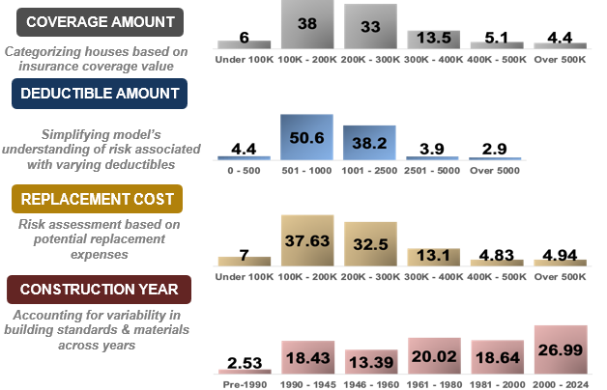
FEATURE ENGINEERING

Slide 15


MODEL BUILDING
:
CoverageAAmount_Binned
Deductible_Binned
ReplacementCost_Binned
ConstructionYear_Era
AgentType
PopulationClassification
HouseholdStatus
RCTMethodID
DwellingUnderConstruction
ConditionID
ConstructionType
PolicyTypeID
FireProtectionID
RoofingMaterialId
County
One-Hot Encoded Variables:
Label (Ordinal) Encoded Variables
Numerical Variables
RoofAge
AnimalCount
YearsSince
InsuranceScoreLevel

Slide 16
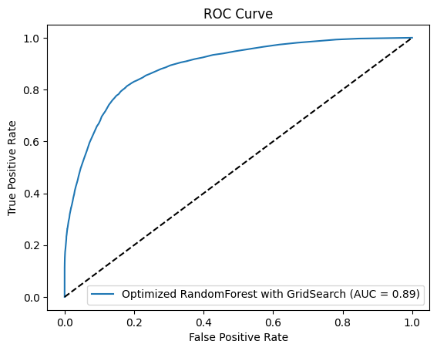
MODEL BUILDING
MODEL TRAINING AND EVALUATION
Data Splitting: Train (80%) test (20%) split ratio allows for a sufficient amount of data to train the models while still reserving a sizable portion for independent evaluation
Cross-validation and Hyper-parameter Tuning: Employed K-Fold cross-validation (5 folds) techniques to ensure model robustness
Hyperparameters tuned to optimize performance
Precision | Recall | F1 Score
0.74 | 0.58 | 0.65

Slide 17
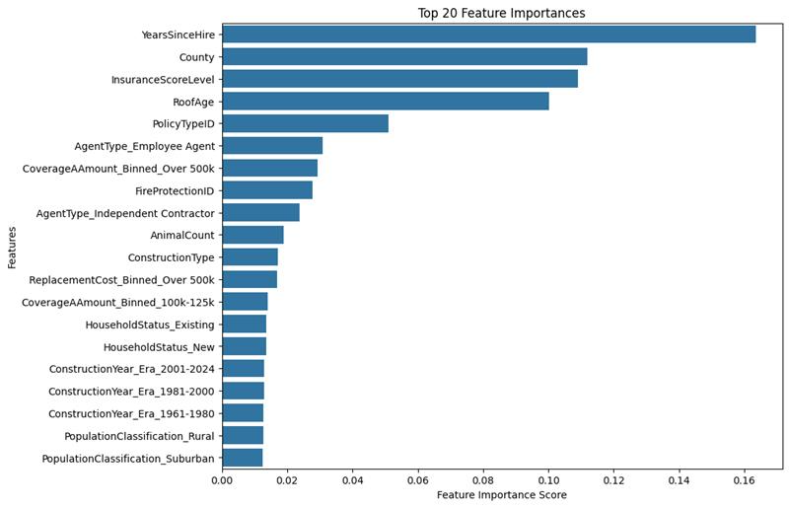
MODEL EVALUATION
MODEL SELECTION
Models with Best Result:
- Identified RandomForest and XGBoost as the
top-performing models
Important Features Identified:
- Highlighted features that contribute most to
detect high-risk houses

Slide 18
MODEL BUILDING
MODEL TRAINING AND EVALUATION
Data Splitting: Train (70%) test (30%) split ratio allows for a sufficient amount of data to train the models while still reserving a sizable portion for independent evaluation
Cross-validation and Hyper-parameter Tuning: Employed K-Fold cross-validation (5 folds) techniques to ensure model robustness
Hyperparameters tuned to optimize performance
Precision | Recall | F1 Score
0.74 | 0.58 | 0.65

Slide 19








BENEFITS
Reduced Risk
Increased
Accuracy
Lower
Costs
Improved
Efficiency
Higher Customer
Satisfaction
BENEFITS

Slide 20

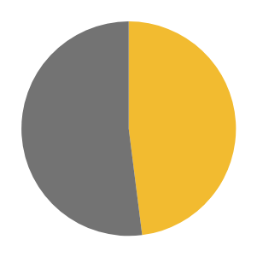
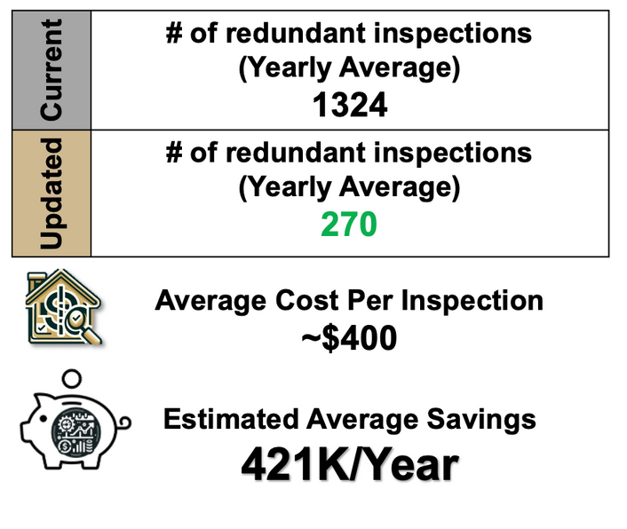
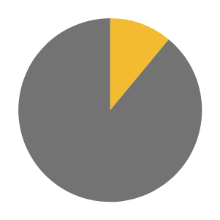
DEPLOYMENT
Current yearly Inspection results
49%
51%
Expected yearly Inspection results
11%
89%
Essential Inspections
Redundant Inspections

Slide 21

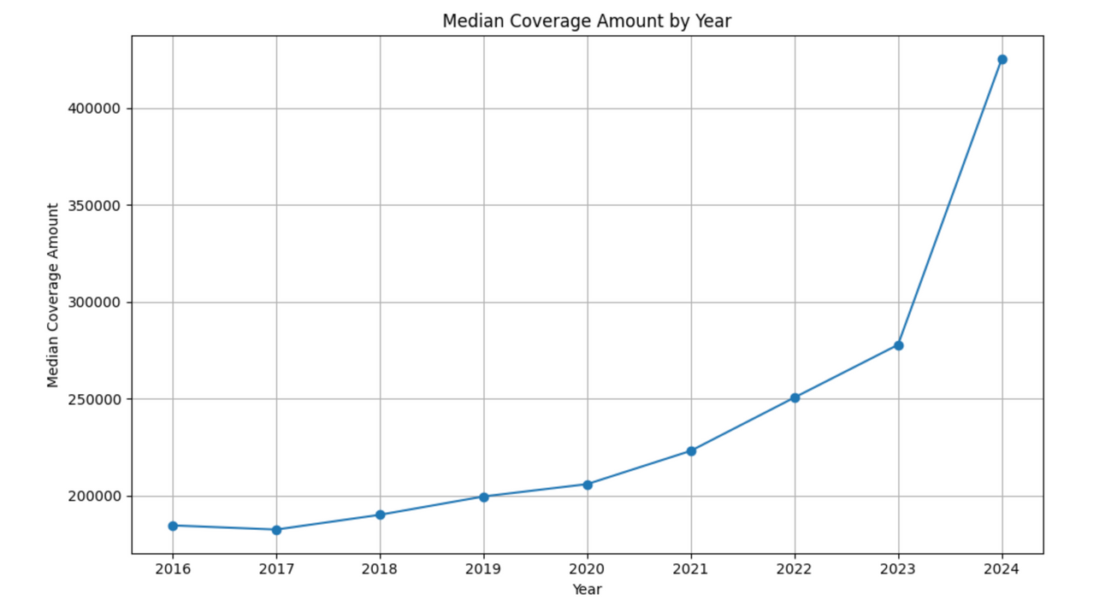

FUTURE SCOPE
Adjust model for market instability and Inflation

Slide 22
FUTURE SCOPE
Adjust model for market instability and Inflation
2. Continuous Improvement/Continuous Deployment based on tests conducted on updated data

Slide 23


THANK YOU
We would like to thank our industry partner, for your guidance and support on this project as well as Purdue MS-BAIM program faculty mentors.

Slide 24
APPENDICES

Slide 25
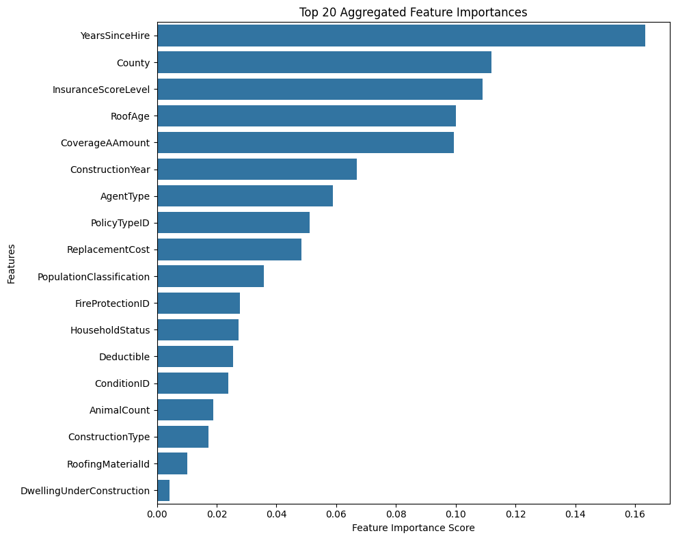
MODEL EVALUATION
AGGREGATED
MODEL SELECTION
Models with Best Result:
- Identified RandomForest and XGBoost as the top-performing models
Important Features Identified:
- Highlighted features that contribute most to detect high-risk houses

Slide 26
COST ANALYSIS
Inspection column
23661 cases
20:00
inspection time
Redundant Inspection
current (total) | updated (total)
11914
2430
Inspection was filled
ChangeTypeID show no change (0)
Total inspection*model accuracy(0.897)

